Slide 1

ANALYSIS
OF
COVID-19 CASES
FROM
2020 - 2024

Slide 2

Introduction
The COVID-19 pandemic, which began in late 2019, has had far-reaching impacts on public health, economies, and societies worldwide. This report aims to analyze COVID-19 data from 2020 to 2024, focusing on various aspects such as trends in new cases, death rates, vaccination rates, and the influence of socioeconomic factors and health behaviors on COVID-19 outcomes.

Slide 3
Research Questions
What are the trends in new cases per million across different continents?
What is the effect of COVID-19 cases and deaths from 2020 to 2024?
What is the COVID-19 cases to death ratio from 2020 to 2024?
What are the vaccination rates for countries in Africa?
How did COVID-19 case trends differ between countries with high and low levels of extreme poverty?

Slide 4
Research Questions
What is the impact of smoking prevalence (male and female) on COVID-19 cases and deaths?
What is the total cardiovascular death rate each year?
How did the number of tests conducted influence the detection of new COVID-19 cases?
What is the percentage of each continent’s population that was tested each year?
What are the average new cases reported for each test unit?

Slide 5
Analysis Steps
Data Collection: The COVID-19 dataset used for this project was downloaded from Our World in Data website: https://ourworldindata.org/covid-deaths. The dataset includes the following columns among others: Death Rates, Vaccination Rates, Test Units, Smoking Prevalence, New Cases and Testing Data.
Data Cleaning and Transformation: Due to the fact that the data have a lot of missing values and some inconsistencies in the data type for each column, cleaning the data becomes necessary to remove unwanted columns, ensure accuracy and completeness of the dataset. The data was then transformed to Handle missing values and standardize data formats.

Slide 6
Analysis Steps
Creation of Facts and Dimension Tables: The covid-19 data downloaded from https://ourworldindata.org/covid-deaths was just a table that contains all relevant covid-19 information. For data modeling purposes and ease of classification of related data, the information in the dataset was grouped into Facts and Dimensions. This forms the basis of creating a Covid-19(FACTS) Table, DimLocation Table, DimTest_Units Table, Date Table and Africa Continent Table.
Attached herewith are the before and after screenshots of the data modeling.

Slide 7
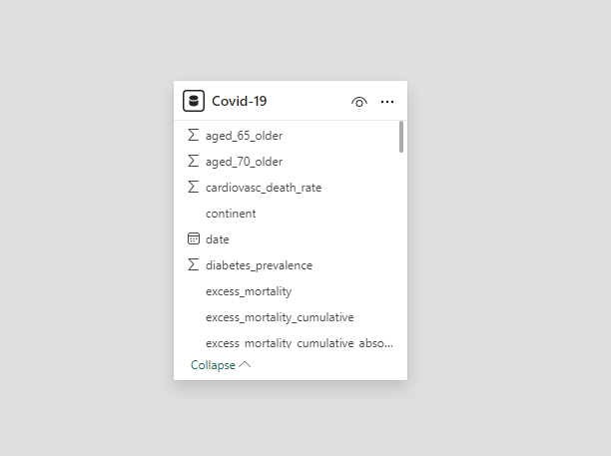
Analysis Steps
Data Modeling Screenshot (BEFORE)

Slide 8
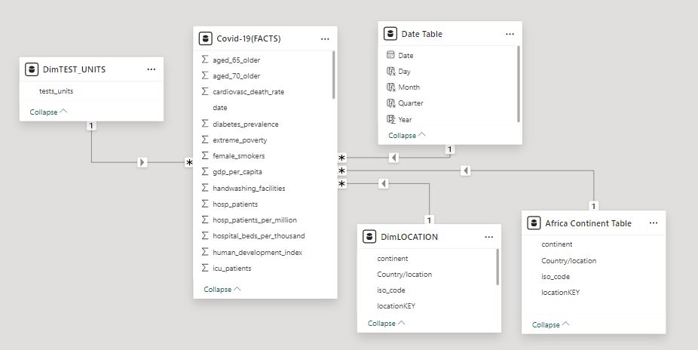
Analysis Steps
Data Modeling Screenshot (AFTER)

Slide 9
Analysis Steps
DAX Calculations:
Calculate new cases per million for each continent.
Analyze the trend of COVID-19 cases and deaths over the years.
Compute the cases to death ratio for each year.
Determine vaccination rates for African countries.
Compare COVID-19 case trends between countries with varying levels of extreme poverty.
Analyze the impact of smoking prevalence on COVID-19 cases and deaths.
Calculate the total cardiovascular death rate each year.
Examine the influence of testing on new case detection.
Compute the percentage of the population tested each year.
Calculate the average number of new cases reported per test unit.

Slide 10
Analysis Steps
Visualization: Use Power BI to create visual representations for each analysis point such as Line chart, Bar chart, Pie chart, Map etc.
Interpretation: Interpret the results and provide insights based on the findings.

Slide 11
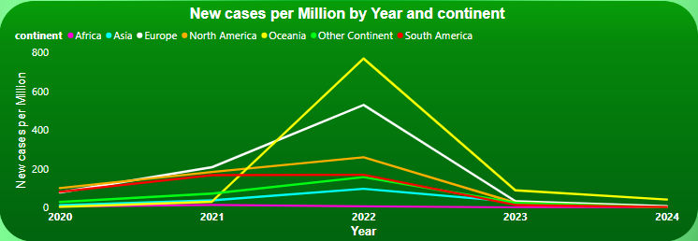
Findings
Trends in New Cases per Million across Different Continents:
New cases per million show distinct trends across continents, with peaks corresponding to various waves of the pandemic.
Europe and Oceania experienced higher peaks in 2022 compared to all other continents.

Slide 12
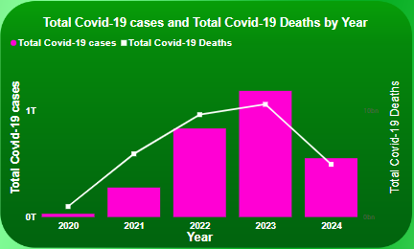
Findings
Effect of COVID-19 Cases and Deaths from 2020 to 2024:
Both cases and deaths followed a pattern with multiple waves. However, the mortality rate decreased over time due to improved treatments and vaccination efforts.

Slide 13
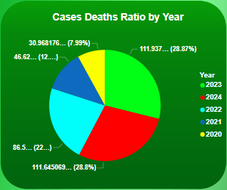
Findings
COVID-19 Cases to Death Ratio from 2020 to 2024:
The ratio varied across different years, with an overall decreasing trend indicating better management and treatment of the disease.

Slide 14
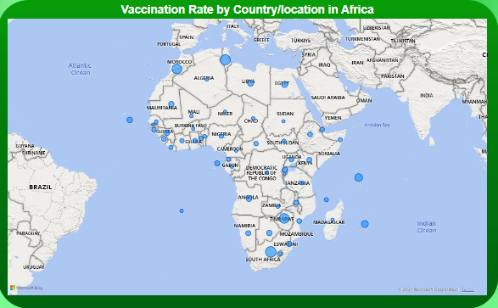
Findings
Vaccination Rates for Countries in Africa:
Vaccination rates varied significantly across African countries, with some countries achieving higher coverage due to international aid and robust vaccination campaigns.

Slide 15
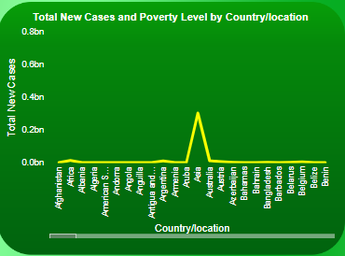
Findings
COVID-19 Case Trends in Relation to Extreme Poverty Levels:
Countries with high levels of extreme poverty generally had lower reported cases, possibly due to limited testing and reporting infrastructure.

Slide 16
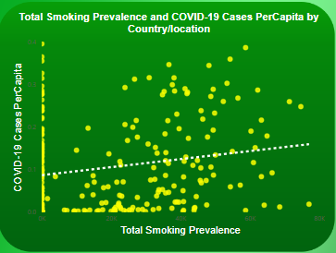
Findings
Impact of Smoking Prevalence on COVID-19 Cases and Deaths:
The analysis shows that higher smoking prevalence, especially among males, resulted in increased COVID-19 severity and mortality rates.

Slide 17
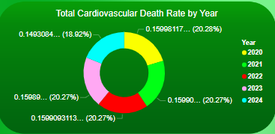
Findings
Total Cardiovascular Death Rate Each Year:
Cardiovascular death rates remained relatively constant, with some fluctuations that could be attributed to the indirect effects of the pandemic on healthcare systems.

Slide 18
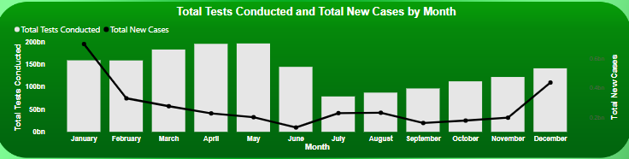
Findings
Effect of Testing on New COVID-19 Cases Detection:
The analysis of the effect of testing on Covid-19 cases detection reveals that increased testing was directly proportional to the detection of new covid-19 cases, highlighting the importance of testing in managing the pandemic.

Slide 19
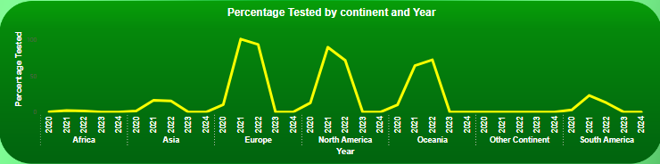
Findings
Percentage of Each Continent's Population Tested Each Year:
The percentage of the population of each continent tested varied widely, with higher rates emerging from continents with more developed countries that have better healthcare infrastructure.

Slide 20
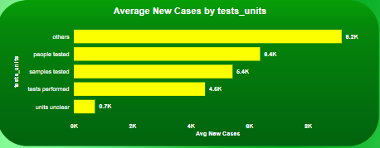
Findings
Average New Cases Reported per Test Unit:
The average number of new cases per test unit decreased over time, indicating improved testing strategies and lower prevalence rates as the pandemic progressed.

Slide 21
Recommendations
Enhanced Surveillance: Improve testing and reporting mechanisms, especially in low-income countries, to better understand the pandemic's spread.
Vaccination Campaigns: Focus on increasing vaccination rates, particularly in Africa, through international collaboration and funding.
Targeted Interventions: Implement targeted public health interventions in areas with high smoking prevalence to reduce COVID-19 severity.
Socioeconomic Support: Provide socioeconomic support to reduce the impact of extreme poverty on health outcomes.

Slide 22
Recommendations
Strengthen Healthcare Systems: Enhance healthcare infrastructure especially in low-income countries and locations with high extreme poverty level to manage both COVID-19 and other critical health conditions effectively through international collaboration and aid.

Slide 23
Conclusion
This analysis provides a comprehensive overview of COVID-19 trends and their determinants from 2020 to 2024. The findings emphasize the importance of robust healthcare systems, equitable access to vaccines, and targeted public health strategies to manage and mitigate the effects of the pandemic. Continued efforts are necessary to address disparities and ensure a resilient global health response to future pandemics.

Slide 24
THE END

